Slide 1
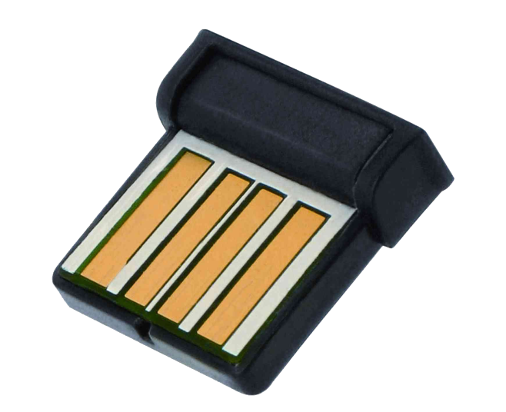
Embedded Bluetooth Stack
Dean Camera
Project Supervisor: John Devlin

Slide 2
Overview
Design and implement an embedded Bluetooth Stack
Create a simple test robot to demonstrate its use
Sensors
Motors
Control robot with consumer Bluetooth devices
Mobile phone for movement
Computer to read and log sensor data

Slide 3

Bluetooth
Simple wireless communication technology
Phones
Headsets
Computers
Short Range
Unregulated frequency band
Three power levels (classes)

Slide 4
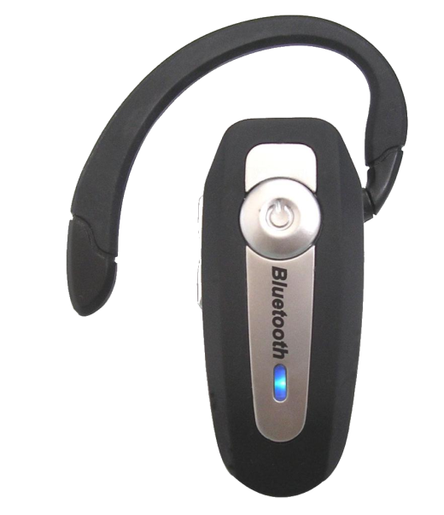
Bluetooth (Cont.)
Keys to success:
Universal compatibility
Custom class support
Low Power
Various standardized classes and services
SDP
HID
RFCOMM
Etc.

Slide 5

Existing Stacks
Free implementations
Linux, BSD, Solaris, etc.
Advantages:
Ready for immediate integration
Large number of standard classes supported
Disadvantages:
Designed for desktop use only
Large, complex, written for devices with MMU

Slide 6

Embedded Bluetooth Stacks
Very few existing embedded stacks
Almost exclusively designed for embedded OS use
Expensive
“Contact Us” pricing model
Restricted Use
Binary Only
Source Code

Slide 7

Previous Work
The LUFA Software Stack
Handles USB layer to the Bluetooth adapter
Proof of concept Bluetooth Stack
Basic functionality
Architectural issues

Slide 8
System Block Diagram
9V Battery
5V Supply
3.3V Supply
Sensor Boards
Level Translator
AVR Microcontroller
LCD, Speaker, LEDs and Buttons
Motors
PWM Controller
USB Bluetooth Adapter

Slide 9
Hardware
Premade robot base
6V DC motors
Gears and tank tread assembly
AA Battery pack
May replace with Li-ion at later stage

Slide 10
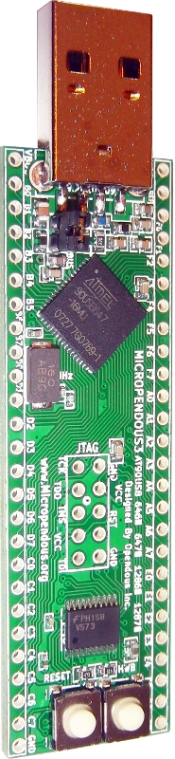
Hardware (Cont.)
Micropendous-3 Control Board
Atmel AT90USB647 Microcontroller
64KB FLASH, 4KB SRAM, 2KB EEPROM
16MHz Crystal for approximately 16 MIPS
USB Connector for USB Bluetooth Module
128KB External SRAM (Packet Buffer)
Speaker, Buttons, LEDs, LCD Display
H-Bridge for dual PWM motor control

Slide 11
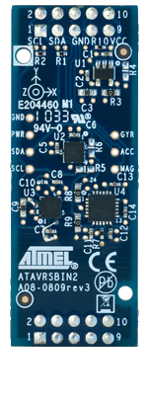
Hardware (Cont.)
Level translated I²C Bus for sensor boards
Atmel INERTIAL ONE sensor board
Temperature
Magnetometer
Accelerometer
Gyroscope
Atmel PRESSURE ONE sensor board
Air Pressure

Slide 12
Firmware
LUFA for low level USB transport
Stack to be written in the C language
Emphasis on:
Low resource usage
No embedded OS requirement
Ability to integrate into existing applications

Slide 13
Firmware (Cont.)
Bluetooth stack layers to implement:
SDP
HID
Manages service discovery and negotiation between devices
RFCOMM
Implements human interface functions such as keyboards and mice
Implements RF communications such as Virtual Serial Ports
Logical Link Control
and Adaption Protocol
Logical channel management within a device connection
Complete Stack
Host Controller Interface
Low level connections between devices
Sends/Receives packets to and from the Bluetooth Controller
USB
Serial
Physical Transport

Slide 14
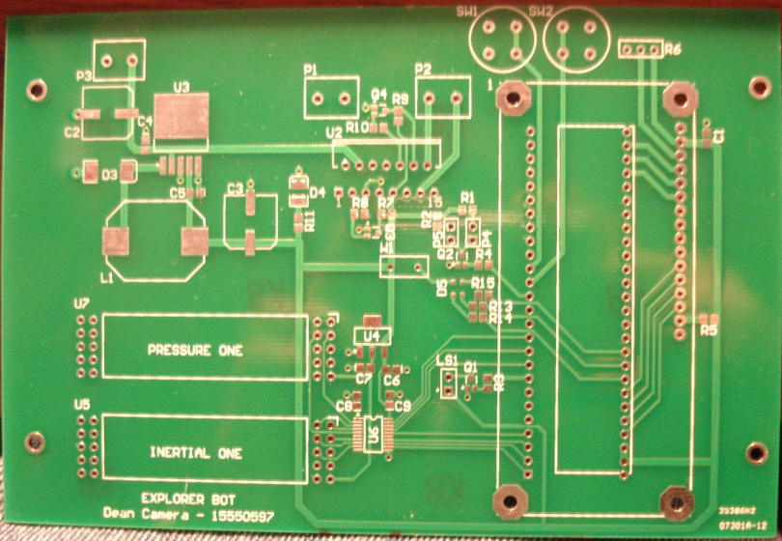
Work Completed
Schematic Designed
Board Layout Completed
Parts Ordered
PCB Ordered and Received
Second board revision ready for manufacture
Coding ready to begin

Slide 15
Timeline
Schematic Design
PCB Layout
Construction
Coding
Testing
Semester 1
Semester 2
Completed
In Progress
Not Started

Slide 16
Thank you for your attention
Questions?

